Slide 1
Revolutionizing Utility with LwM2M Ecosystem
Feb 8th, 2023

Slide 2
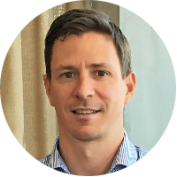
Our Presenters
Andrew Forster-Knight
General Manager Digital Utility
Olivier Carmona
Head of Sales & Marketing
Travis Shanahan
Senior Research Architect

Slide 3
Housekeeping
Recording and slide deck will be made available for attendees via email and on the OMA SpecWorks website.
Questions can be asked via the webinar chat and will be answered at the end of the presentation.
Additional questions can be sent to helpdesk@omaorg.org.

Slide 4
SEW IoT Journey
Success with LWM2M
Andrew Forster-Knight
General Manager – Digital Utility

Slide 5
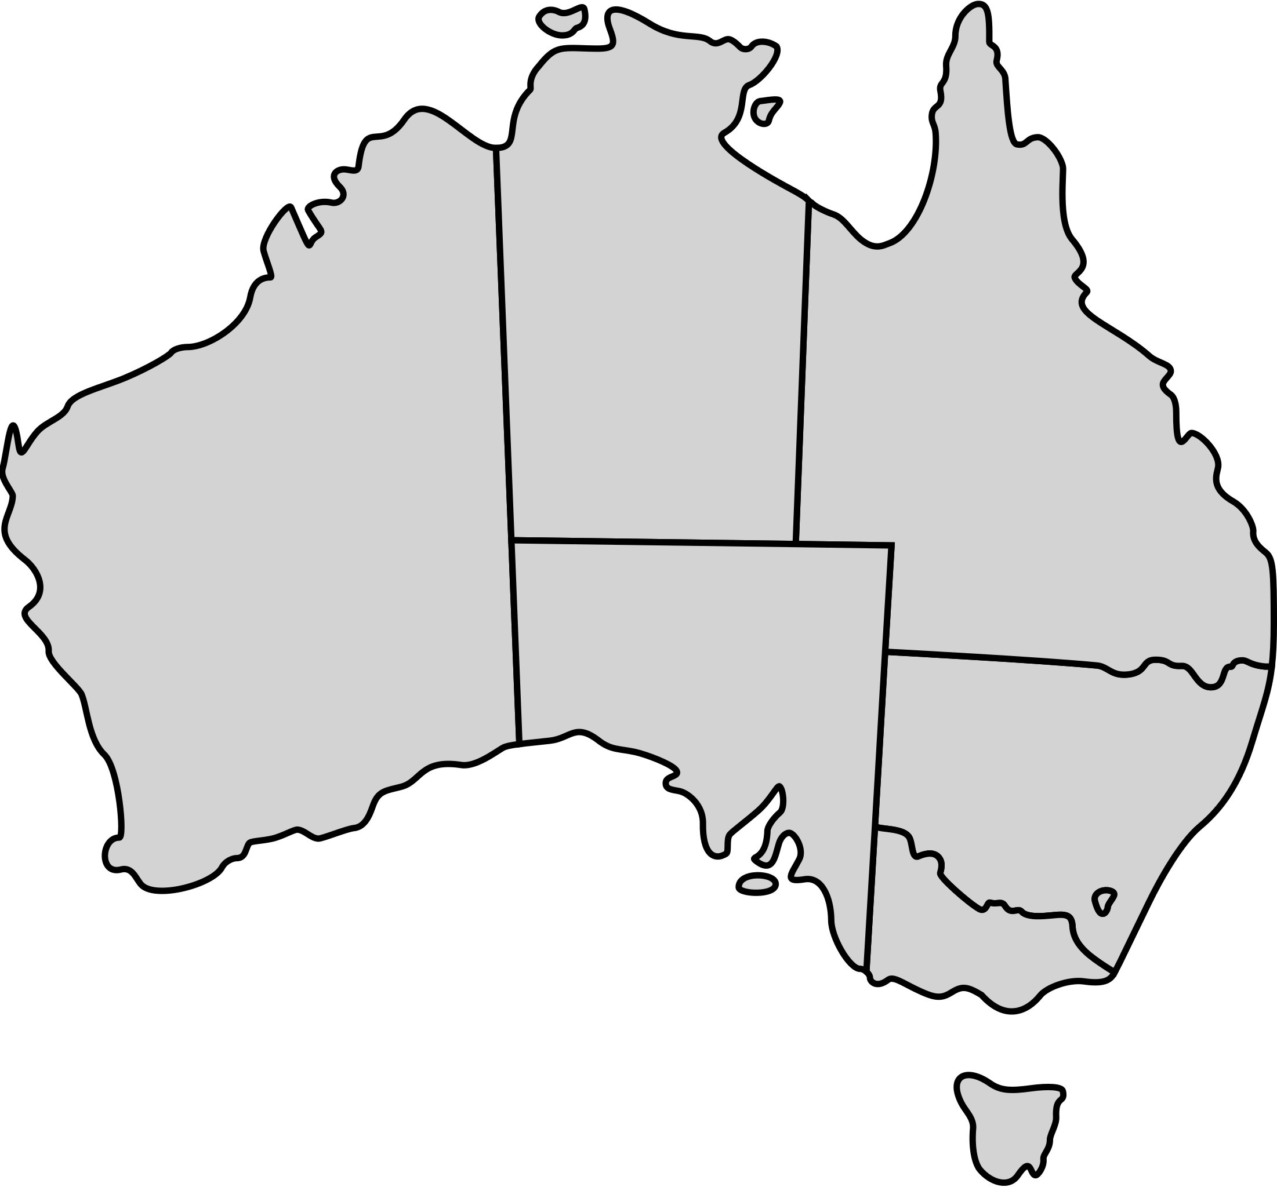
Since then…
About South East Water
We deliver the water, sewerage and recycle water services of 1.91 million people in the South East of Melbourne
Melbourne
Our new Internet-of-Things asset base currently includes >100k battery powered devices across our water and
waste water networks. We plan to grow this to ~ 1 million devices in the next 4 years
Photo: Melbourne Water

Slide 6
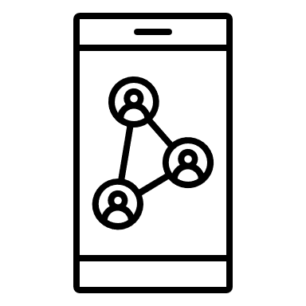
Since then…
Digital Transformation
Transform the way we operate by acquiring and analysing real-time data from multiple sources enabling us to better serve our customers and to run our networks more efficiently.
Key challenges
Climate Change weather variability, water availability and quality,
asset resilience
Customer expectations we are unable to inform customers of real-time
water usage and network faults
Proactive Network Management we want to make data-driven decisions
Photo: Melbourne Water

Slide 7
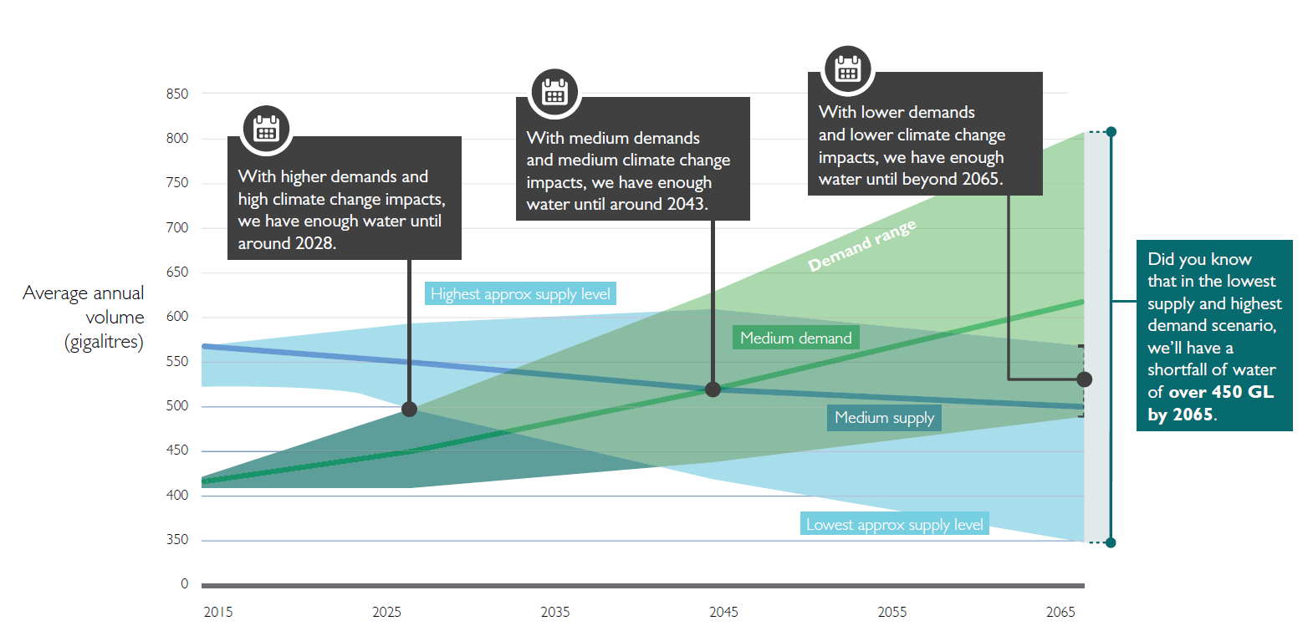
Water Scarcity Drives Need for a Smarter Approach
Supply and demand scenarios in Melbourne
Notes:
I think most of you here today are very familiar with some of the big challenges facing the Water industry in Australia and here in Melbourne
There is a lot of information in this slide which is taken from a recent study by Melbourne Water looking at Melbourne’s long term water supply / demand picture for the next 50 years
The key message here is that we run the risk of not having enough water as earlier as 2028 if we don’t act now !
Climate change is impacting the supply side and increasing urban growth is impacted the demand side
Another way of summarises this is as follows …..

Slide 8
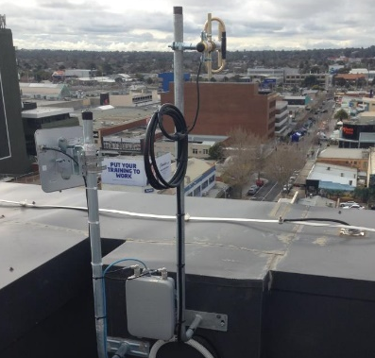
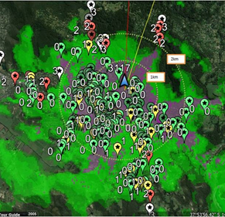
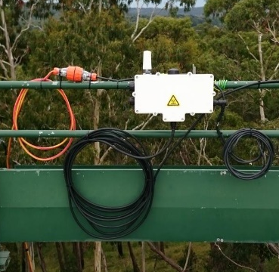
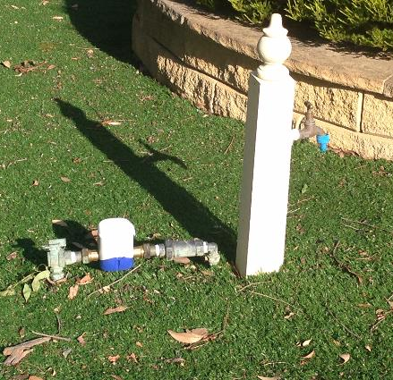
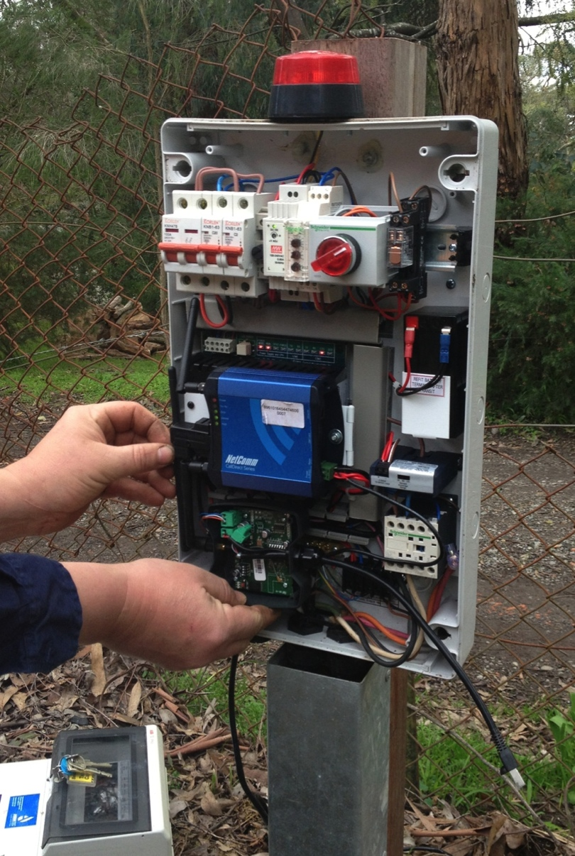
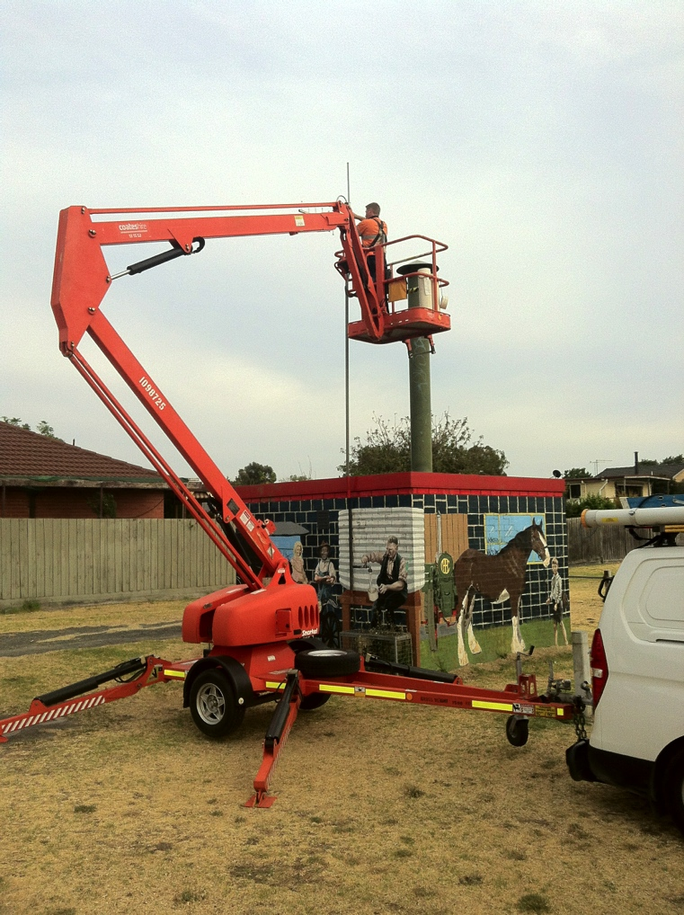
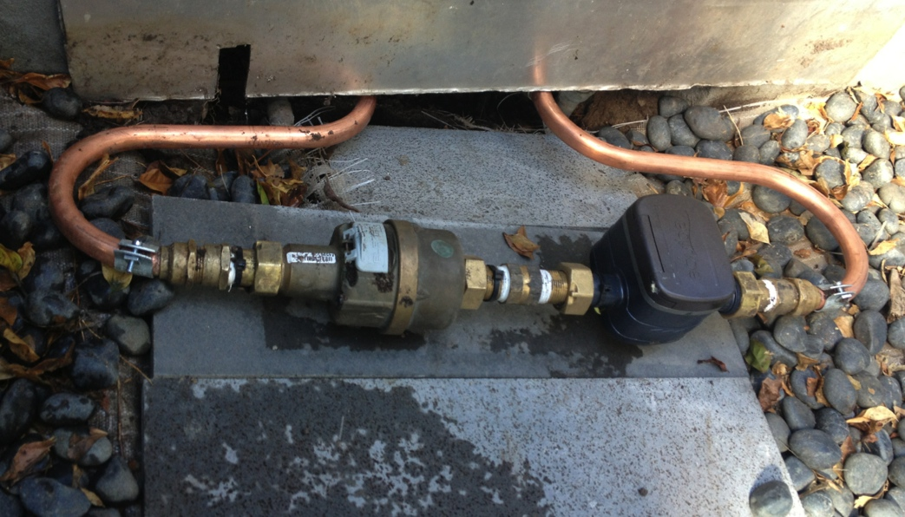
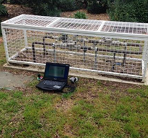
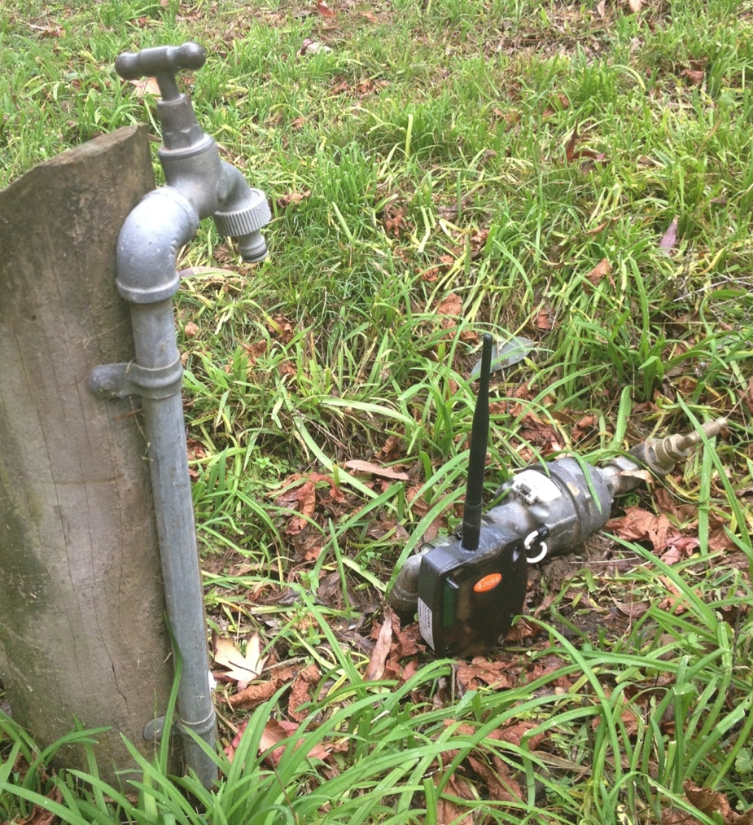
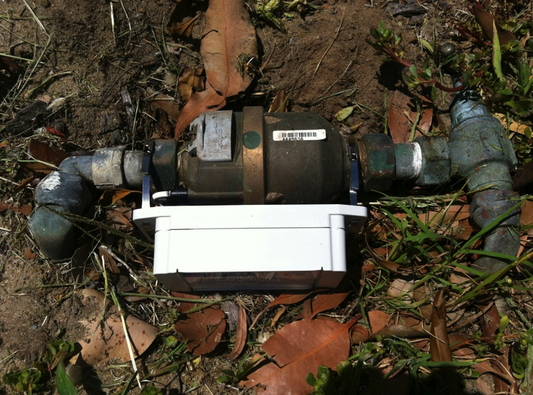
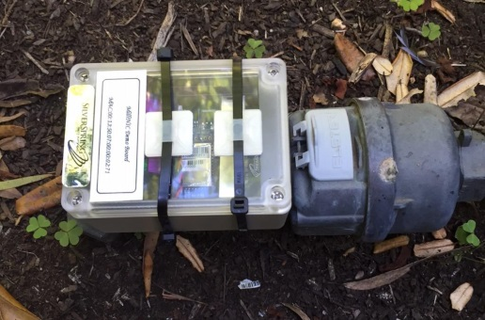
SEW’s IoT journey
Tested and trialled many technologies (mostly proprietary)
Helped to form our opinion on build vs outsourced IoT networks
Many learnings around battery efficiency and data transfer
(2015)
LPWAN IoT trials
(2016)
First NB-IoT
Digital Meters
(Dec 2016)
(2013)
(2014)
(2013)

Slide 9
IoT strategy
Strategic decisions were made around the technology stack
We needed a communication technology that met our needs:
Secure and future-proof: Telco grade communications that is operated by trusted partners (in for the long term)
Coverage: Three carriers in Melbourne, all with full NB-IoT coverage across our large footprint
Standards based: Large, growing ecosystem globally
Low cost, Low power: 10+ years easily met for digital water meters
Two-way communication: Allows for FOTA, configuration and reliable data integrity
We also wanted to focus on the data and transformation, rather than having to build and manage new radio infrastructure
Once we selected our LPWAN technology, we also needed to select the best protocol to meet our strategy:
OMA LightweightM2M selected for digital metering and network sensing applications
Efficient battery life enabled by LWM2M protocol and design
Highly extensible protocol that would allow us to manage large IoT fleets in a consistent manner
Already selected by most MNO’s for managing IoT devices (backed by large industry and chipset providers)
High levels of data security

Slide 10
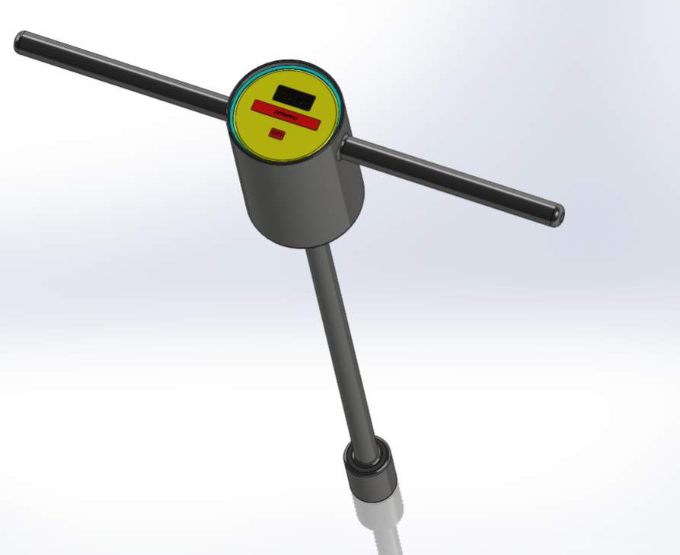
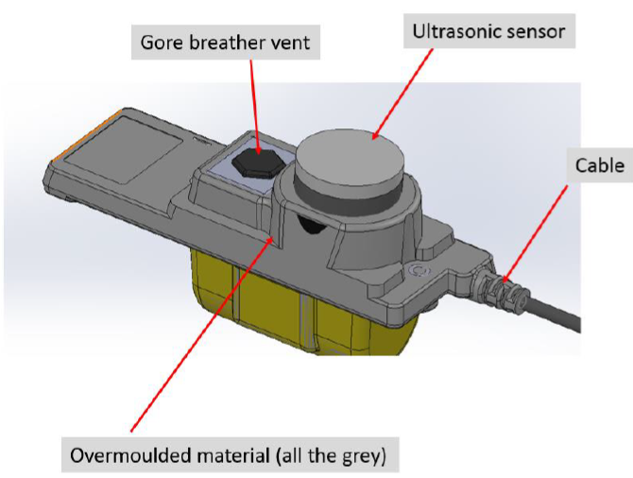
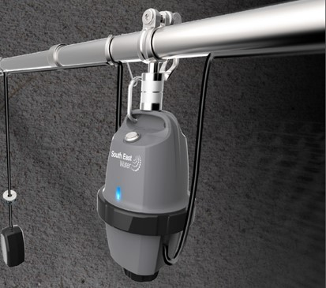
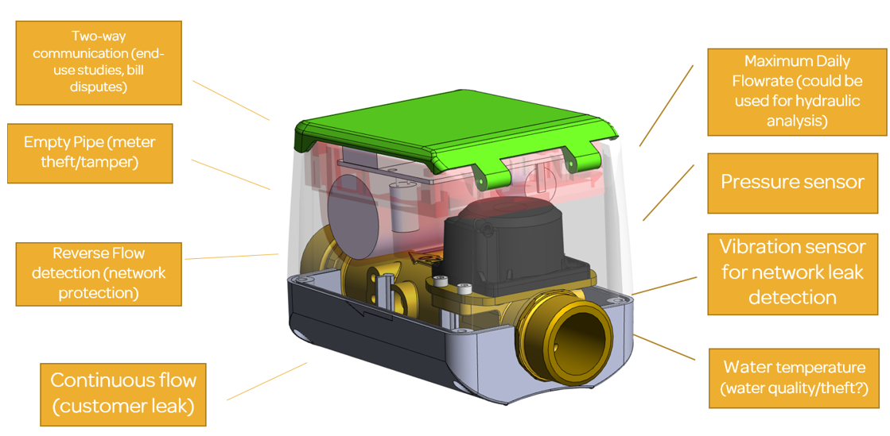
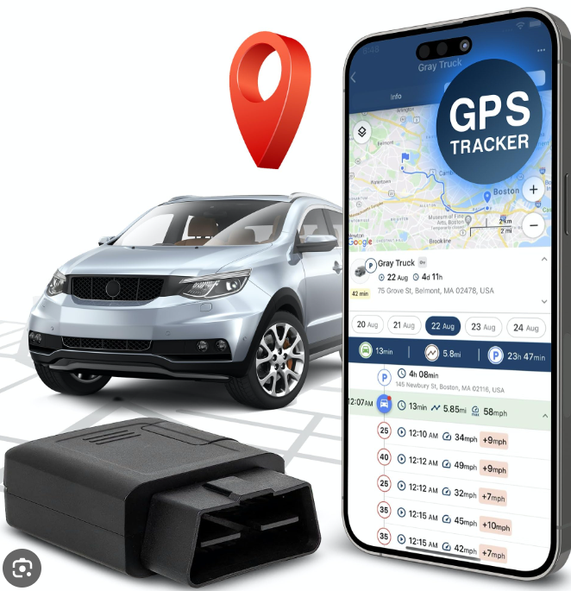
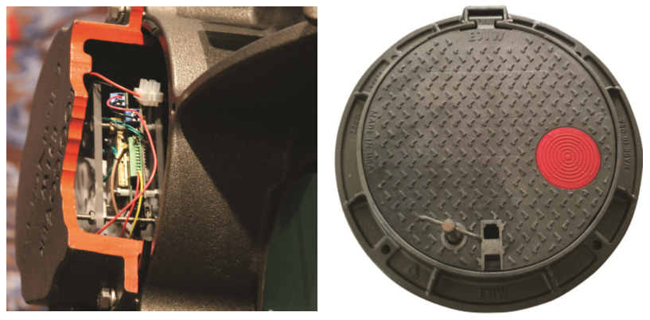
Our IoT ecosystem
- Sewer level monitoring (with embedded sensors)
- Pump control at customer properties
- GPS tracking of vehicles and plant
- Digital meters (with embedded sensors)
- Portable valve keys
- Animal detection at water tank sites
- Network pressure and flow
- Cathodic monitoring for pipe condition
Notes:
Maximise investment opportunity by investing in edge intelligence – Whether its embedding has detection into our sewer overflow or in the case of DM………
Strategic tech decisions

Slide 11
IoT will underpin service delivery from end-to-end
Validates and stores usage data
Generates Bill
Records and transmits usage
Collects Data and Manages Networks
Billing
Meter Data Management
Digital self service and proactive communications
Battery operated digital meter
Customer Portal (mySouthEastWater)
Install
Commission
Internet of Things Communications Networks
IoT
Platform
Other IoT
devices
Asset Planning
Advanced Analytics
Transmits state and asset data
Receives commands and configuration
Real time network operations and management
Water
devices
Network Operations
(SCADA)

Slide 12
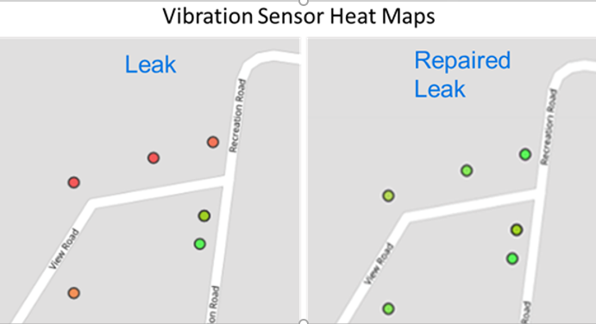
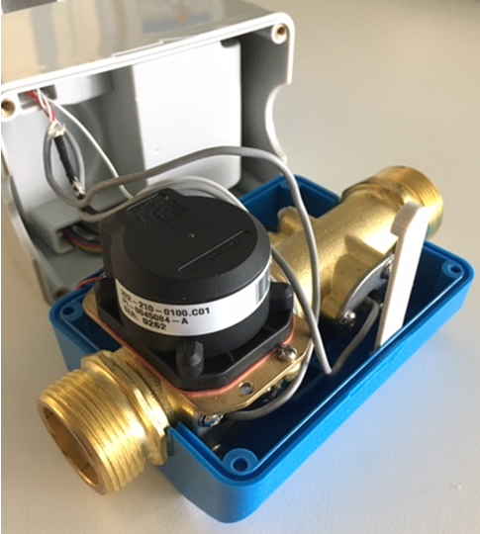
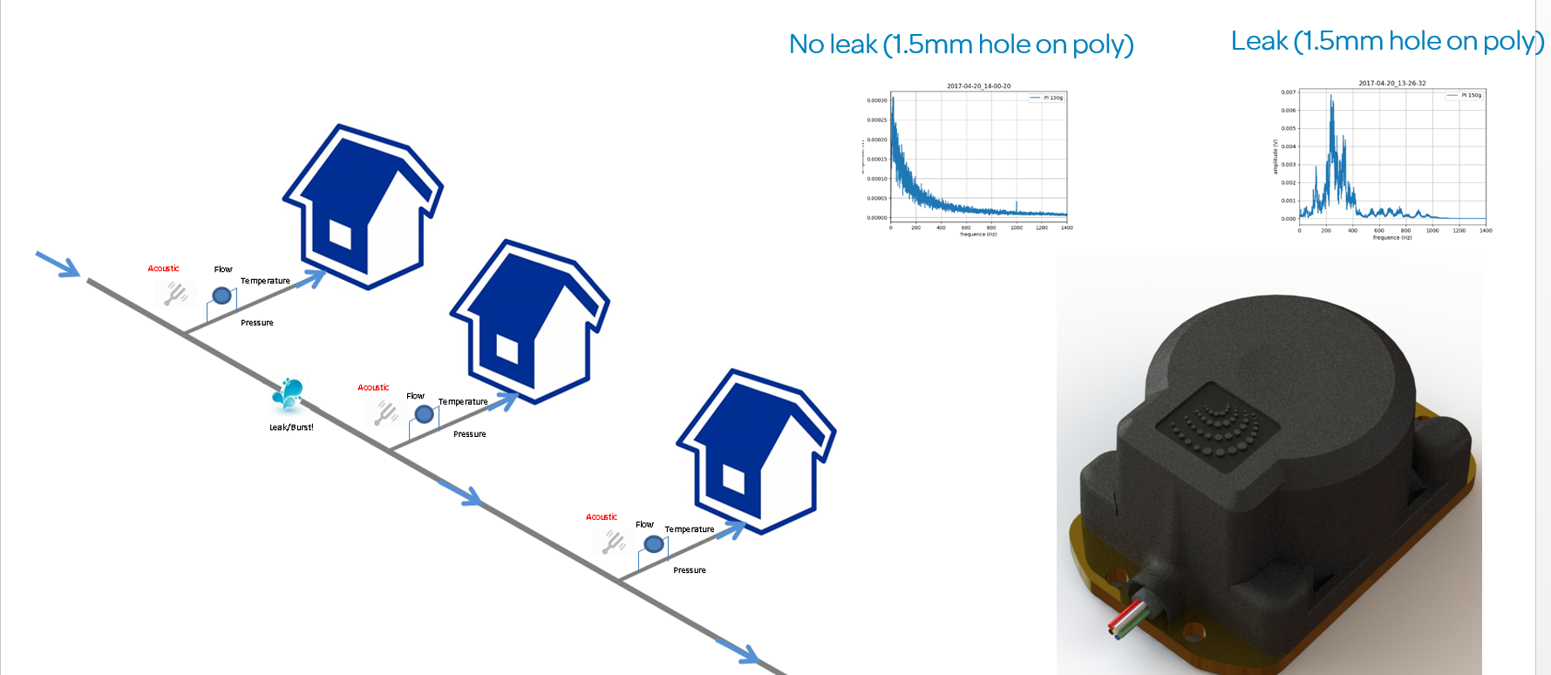
IoT Case Study : Network leak detection at scale
..Meters ‘listen’ for leaks each morning between 12am – 2am
..Meter determines if vibration is due to customer consumption OR network side leak

Slide 13
Heatmap visualisation – leakage ‘hot spots’
Vibration intensity

Slide 14
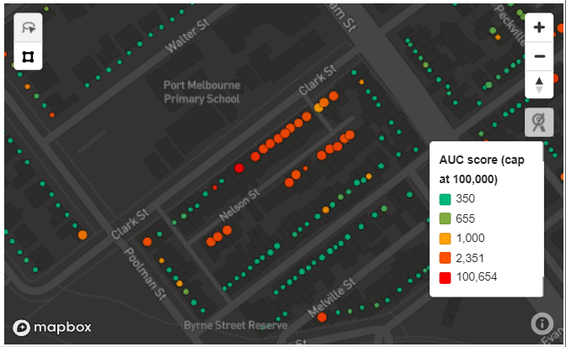
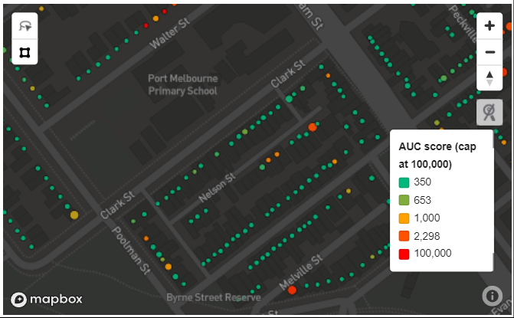
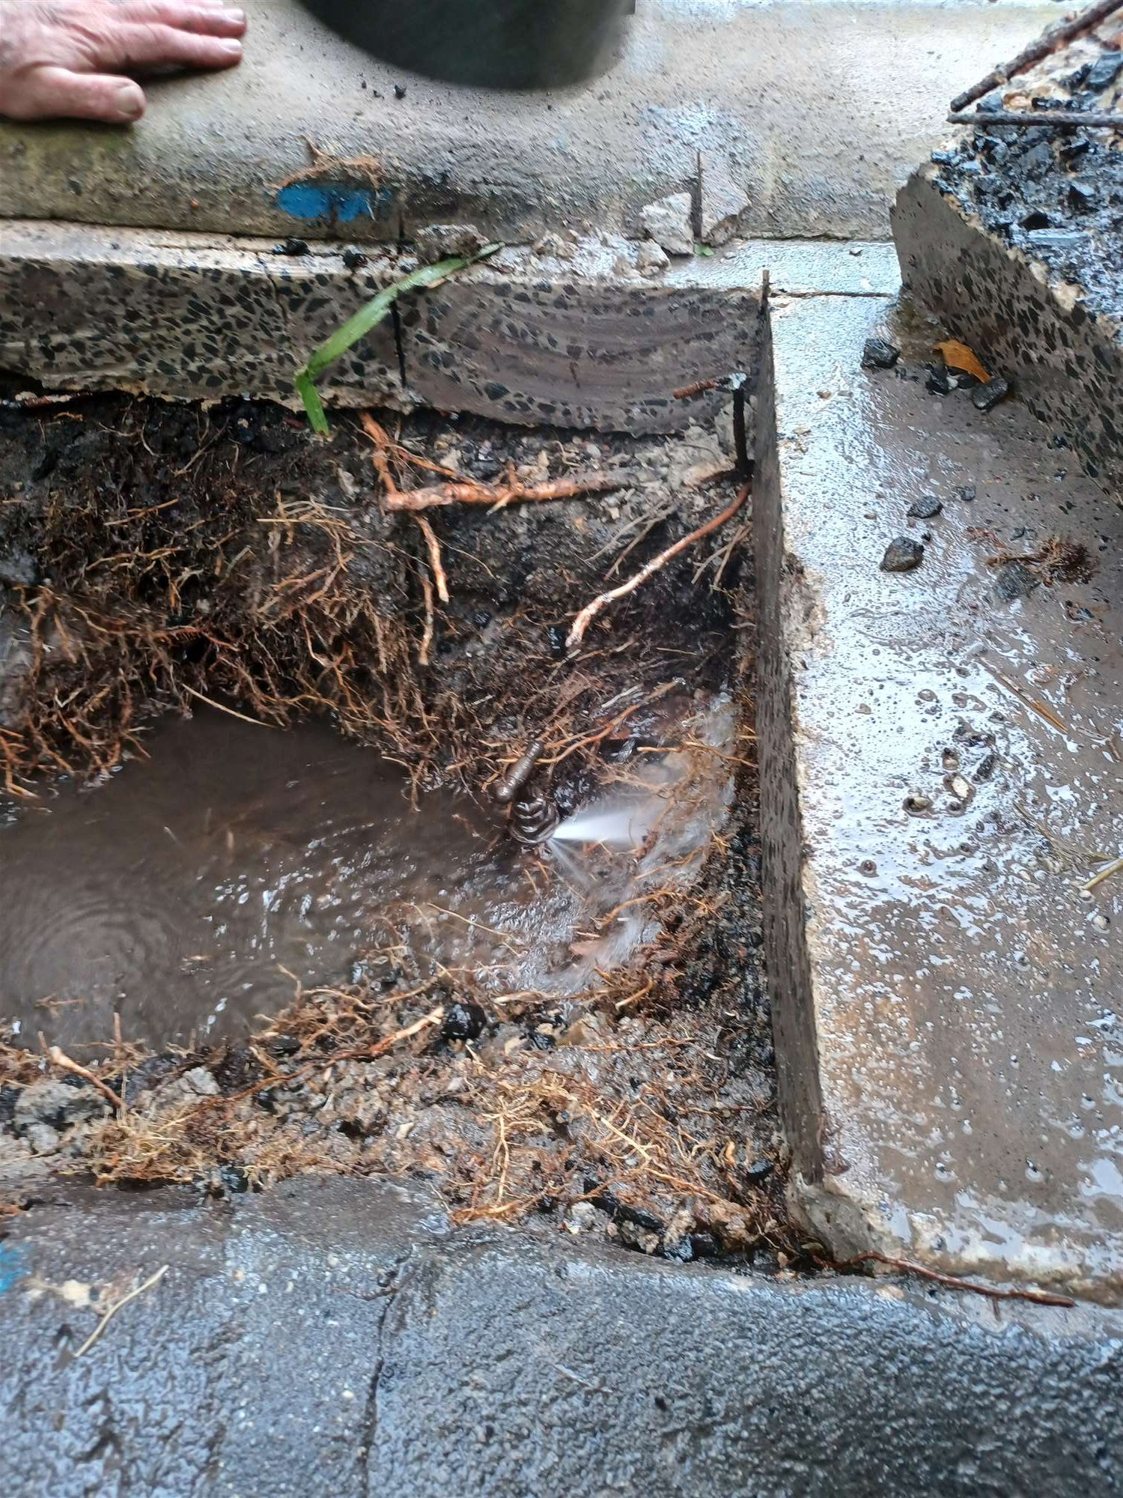
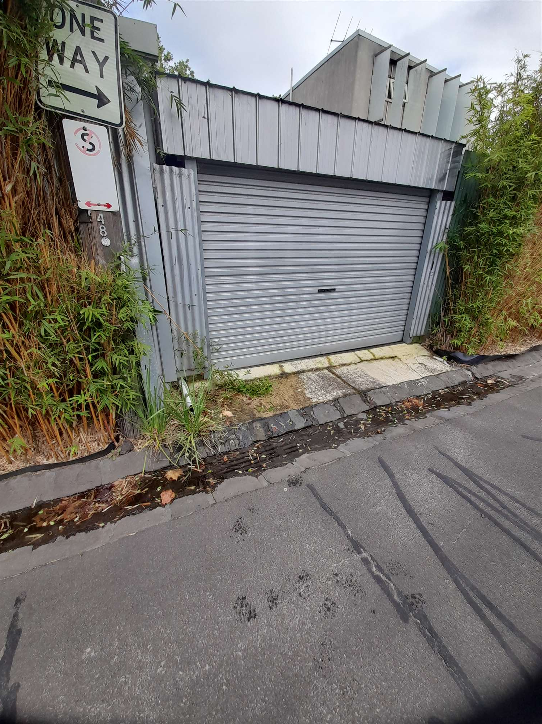
Case Study
Before repair
Leak
After Repair
The Opportunity
Vibration energy graph
Leak repaired
Leak begins to grow
Evidence of leak

Slide 15
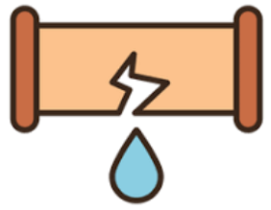
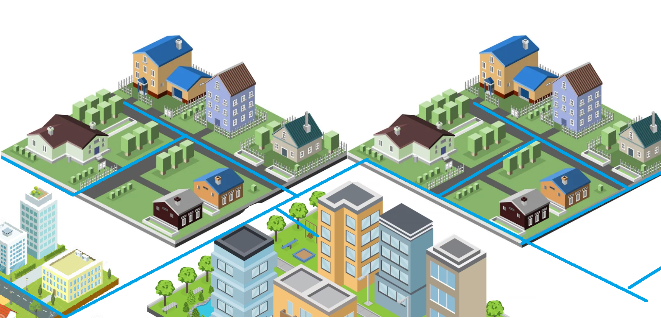
Future-state optimisation
Leaks automatically identified, categorised and prioritised by analytics systems each day
Works are ‘batched’ together based on proximity and urgency and automatically dispatched to crews
Future-state optimisation
Crews work ahead to excavate each leak
Repair crews follow to fix leak
Slow-leaking main
Leaking service pipe
Leaking service
pipe
Stop tap leak

Slide 16
South East Water Outcomes at Scale
Reduced Network Leaks
Reduced Customer-side Leaks
Saved by customers
Average saved off customers next quarterly bill
Expected water saved
(Annually at full deployment)
Integrated meter/leak
sensors deployed
£2.4 million
£210
Water saved from 81,900 meters deployed
Customers notified of a potential leak
1.63 GL
(>1% NRW reduction)
85,000 meters
(900k to go!)
1.1 GL
11,900
(13%)
Data on Jan 25, 2024
Notes:
Based on initial trials of 5,000 Sotto enabled meters in Port Melbourne, SEW was able to validate the technology and as I mentioned have expanded their trial deployment to 30,000.
With the support of Jacobs, SEW was able to also validate that at least 1% reduction in NRW is possible and economically deliver a yearly water saving of at least 1.63GL at scale
Not only are these DWM’s reducing network leaks
Reducing bill shock and residential water demand through automated continuous flow alarms to customers is already have an impact from the 80,000 DMW also deployed so far :
Close to 13% of customers been notified or potential leaks
Saved customer $2.5M so far and reduced their bills by around $400 on average per quarter
And saved close to 1,000 ML’s of water

Slide 17
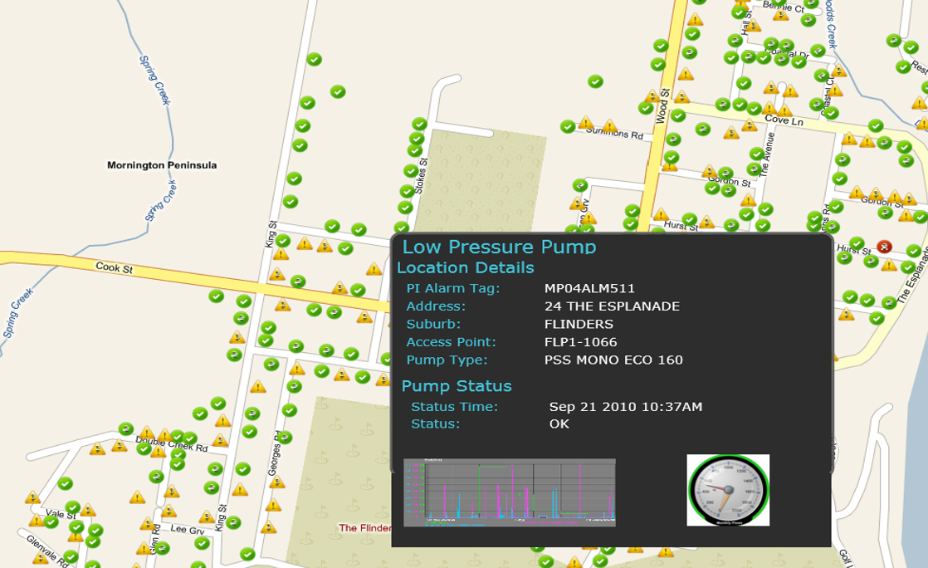
IoT Case Study : Smart sewer network

Slide 18
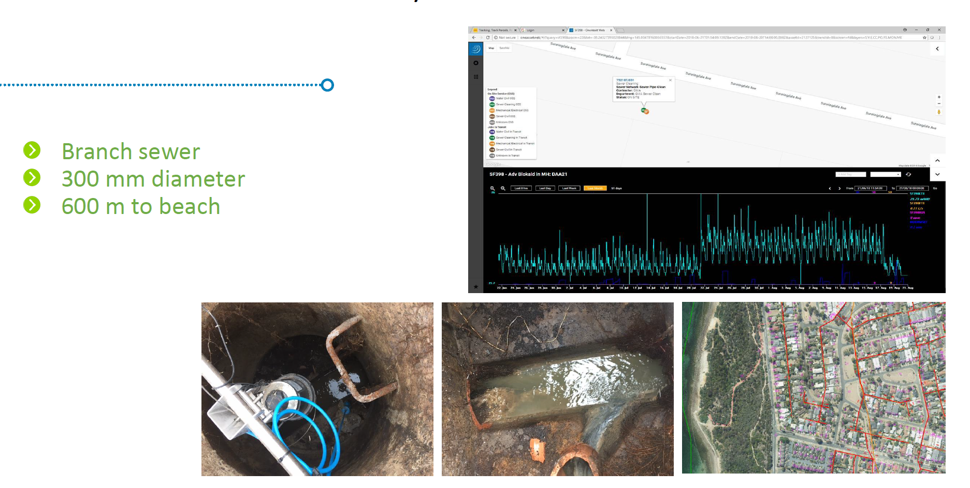
IoT Case Study : Smart sewer network
Large scale deployment of sewer level sensors
Predictive condition assessment
More than just an overflow alarm

Slide 19
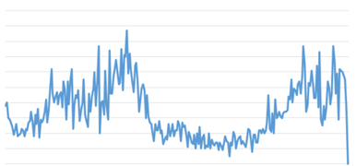
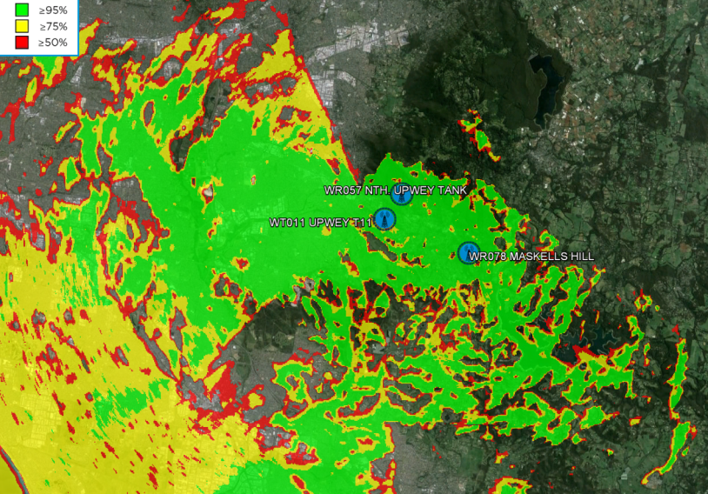
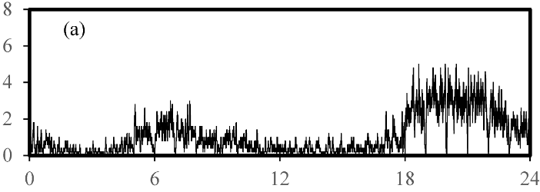
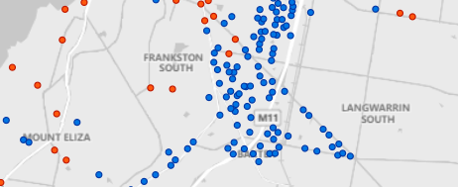
The role of LWM2M
(1) Requesting additional data from devices as needed (queueing request)
Example- waveform data from acoustic devices
Example- requesting signal strength data for diagnostic purposes
(2) OTA Configuration changes
Example- changing flow interval for customers to get more granular detail
Example- configure new wake/transmit times to improve data collection or system throughput
(3) FOTA at mass scale (for both device firmware and modem firmware)
State-machine for image delivery
Handles poor connections well
Efficient process (less battery impact)

Slide 20
What is LwM2M?

Slide 21
LwM2M Offers Device Management Protocol for IoT
Developed by OMA SpecWorks to address the needs of IoT devices
LwM2M defines, secure remote operations.
LwM2M offers data format for a large variety of use cases.
LwM2M defines access controls, encryption, and firmware update.
Deployed since 2016 for cellular IoT

Slide 22
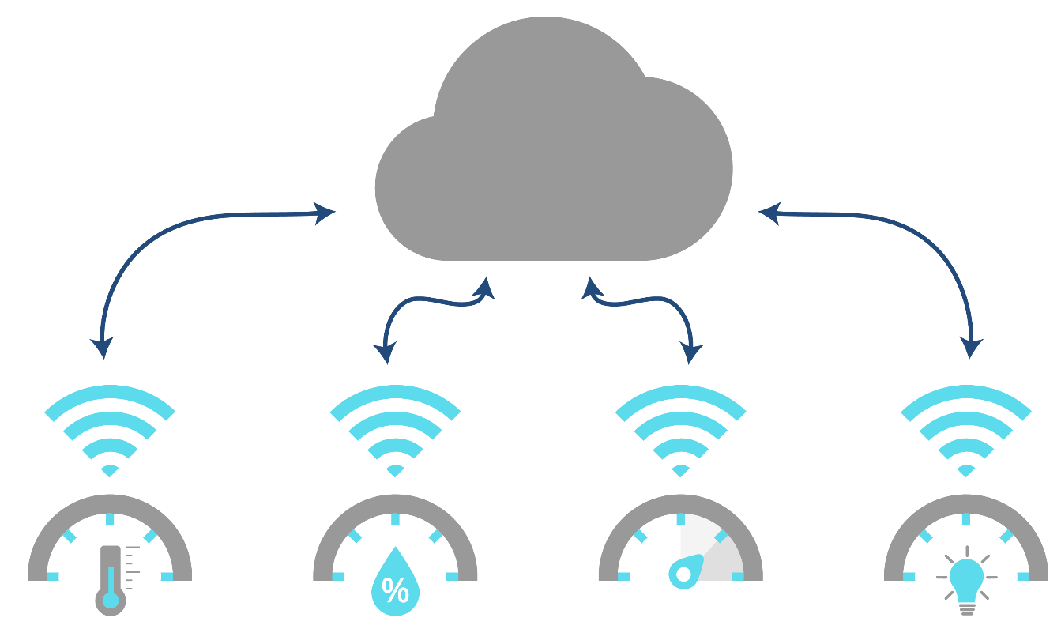
LwM2M Offers Standard Lifecycle Management
Allows device lifecycle whatever brand, whatever device.
Do it once.
Use it everywhere.
Temperature Sensor
Brand A
Humidity Sensor
Brand B
Pressure Sensor
Brand C
Light Sensor
Brand D
Notes:
Large-scale IoT deployments like smart water metering, smart farming, or smart city scenarios require multiple types of devices. These devices include IoT gateways, sensors, and meters, and they have the ability to share and receive data.

Slide 23
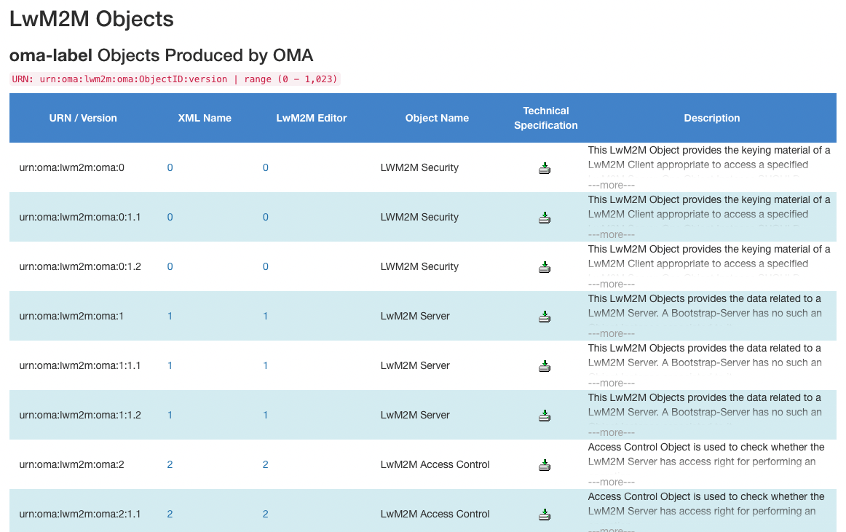
LwM2M Offers Standard Data Format
Allows device operation interoperability beyond lifecycle management.
1,000+ objects to help your business
Open for contributions
Maintained by OMA SpecWorks, it also contains objects from IPSO, GSMA, uCIFI, OneM2M
Objects cover the most common Device Management and business use cases
https://technical.openmobilealliance.org/OMNA/LwM2M/LwM2MRegistry.html

Slide 24
LwM2M Offers A Safe Control Plane
At any time you can recover devices thanks to LwM2M Bootstrap
LwM2M Bootstrap Platform
When a device initiates a bootstrap operation—either automatically upon installation or upon request from its current LwM2M Production Server—the LwM2M Bootstrap Server check first device credential before supplying device the necessary credentials and the address of a LwM2M Production Platform.
Device
The device then updates its configuration with these new credentials and targets the specified platform for connection.
LwM2M Production Platform
This bootstrap process provides:
A touch-less and secure bootstrapping mechanism during installation.
A means to recover devices that have either expired credentials or are in a critical state.

Slide 25
LwM2M Protocol Encompasses All Comm Protocols
Works on any physical layer thanks to CoAP transport protocol versatility
High Latency Network
Low Latency Network
Mesh Network
LwM2M on to of CoAP over UDP IPv4
Link Layer Security: DTLS
Application Level Security: OSCORE
LwM2M on to of CoAP over TCP IPv4/v6 or over SMS
Link Layer Security: TLS
Application Level Security: OSCORE
LwM2M on to of CoAP over UDP or TCP IPv6
Link Layer Security: TLS
Application Level Security: OSCORE
NB-IoT, Satellite
LTE-M, LTE
WiSUN

Slide 26
LwM2M Answers Regulator Security Requirements
Answer to the three laws of cybersecurity
You Shall Encrypt
LwM2M defines encryption at link and application level
You Shall Not Use Unique Password
LwM2M defines a bootstrap operation for installation or for recovery in the field
You Shall Update Firmware
LwM2M defines a firmware update operation.

Slide 27
LwM2M Object Resources
/
+- 3 (Device Object)
| +- 0
| +- 2 (serial number, R)
| +- 4 (reboot, E)
| +- 9 (battery level, R)
| +- 14 (current time, RW)
|
+- 4 (Connectivity Monitoring Object)
| +- 0
| +- 1 (available networks, R)
| | +- 0 (1st available network)
| | +- 1 (2nd available network)
| +- 2 (signal strength, R)
| +- 8 (cell ID, R)
|
…
A collection of Resources relevant for a particular use case
Each resource has a defined semantic, type and allowed operations
Well-known 16-bit IDs
Resources and Objects can have multiple Instances
Resources can be optional
Objects/Resources are accessed with simple URIs:
/{Object ID}/{Object Instance}/{Resource ID}

Slide 28
LwM2M Ways Of Collecting Data
LwM2M Server
LwM2M Operations
READ Data when server needs
SEND
Data based on self configuration
OBSERVE data based on attribute, such as step translating in a deadband.
Schedule OBSERVE to receive data when values change
Manual mode
Scheduled
Unsolicited mode
LwM2M Client
Provides answer to server when triggered
Send Notifications when values changes. Conditions could also be set.
Send data based on device application configuration
Read mode enables occasional server status checks.
Send mode suits devices with intermittent network access, like those using energy harvesting.
Observe mode centralizes device logic in the cloud, allowing flexible operational adjustments based on the device's working conditions.
Notes:
LwM2M features

Slide 29
LwM2M Concepts Applied To Metering
Security Config
Server Config
READ
Device Information
WRITE
Firmware Update
EXECUTE
Connectivity Monitoring
OBSERVE / NOTIFICATION
Connectivity Statistics
SEND
Water Meter
LwM2M Client
LwM2M Objects
LwM2M Operations
LwM2M Server

Slide 30
LwM2M Library of IP Smart Objects (IPSO)
1,000+ objects to help your business
Open for contributions
Maintained by OMA SpecWorks, it also contains objects from IPSO, GSMA, uCIFI, OneM2M, and individuals
Spread over a range of 16bit/65535:
0 – 1023 | Objects produced by the OMA
2048 – 10240 | Objects registered by 3rd party standards organizations
10241 – 26240 | Objects registered by companies or individuals
32769 – 42768 | IDs reserved by vendors. Objects are not published
Overall five classes of devices:
Device Lifecycle Management
Connectivity Management
Security Management
Generic Sensor or Actuator Management
Application Dedicated Object
https://technical.openmobilealliance.org/OMNA/LwM2M/LwM2MRegistry.html

Slide 31
LwM2M Accelerates Device Development
Plus, ensures product safety with a secure control plane
Without LwM2M
Development
Maintenance
Select transport protocol
Select secure encryption layer
Define & Build device communication architecture
Define & Build installation procedure
Define & Build data payload
Define & Build firmware update procedure
Remotely control device
With LwM2M
Development
Maintenance
Install LwM2M client on a device
Select LwM2M objects
Use a LwM2M server
Remotely control any LwM2M device

Slide 32
LwM2M Interoperability Program

Slide 33
Purpose of the Project
OMA is seeing an uptick in members from the utility industry who are interested in LwM2M.
Utility RFPs are increasingly calling out LwM2M in their tenders and utility suppliers are developing around LwM2M at an increasing rate.
Not all the implementations conform to the specification, creating interoperability issues.
OMA wants to provide a single-point-of-reference for this important industry segment
Notes:
A place to collect utility-specific use cases and fold them into the core Specification
A place to develop and register new Objects that interact with the LwM2M protocol
A place to develop test cases and host interoperability test events
A place to develop an international conformance and certification ecosystem that will allow utilities to deploy LwM2M-based products with confidence.
A place for members to publicly post LwM2M-compliant utility products and interop test results.

Slide 34
Specification Validation Event

Slide 35
Interoperability Testing
Current State
Test Fest/ SVE
Core Objects vs Industry app objects
Testing Tools
Validation/Certification

Slide 36
Current State – Test Fest
https://www.openmobilealliance.org/release/LightweightM2M/ETS/OMA-ETS-LightweightM2M_INT-V1_2-20231003-A.pdf

Slide 37
Testing Profiles
DMSO Core Objects
Industrial Device related objects
Water Elec and Gas meters
UCIFI streetlights and smart city objects
Others?
Industrial optimization testing
Bootstrap pack
Compact composite sends
Constrained network simulations
Bootstrap
FW Update
Network Connectivity

Slide 38
Testing Goals
Interoperability Testing: Participants test their products and services to verify that they can work seamlessly with other vendors, ensuring that devices and services from different manufacturers can communicate effectively.
Standard Compliance: Products and services are assessed to ensure that they adhere to the OMA's established standards and specifications, promoting consistency and compatibility in the mobile industry.
Issue Resolution: Any interoperability issues or discrepancies discovered during testing are addressed and resolved, helping to improve the overall quality and compatibility of mobile technologies.

Slide 39
Step | Description
1. | Define Objectives and Scope: Clearly define the objectives of the Virtual TestFest and determine the scope of testing, e.g., test v1.0, v1.1 & v1.2 of the LwM2M Protocol.
2. | Form an Organizing Team: Assemble a dedicated team with assigned roles and responsibilities. Historically, OMA TestFest Events were run by OMA staff. Now that OMA employs party-time contractors, it is a good opportunity for some members to step forward and take some role during the event: TestFest Manager: TestFest Project Manager: TestFest Registration Support:
3. | Set a Date and Duration: Choose suitable dates and decide on the duration of the event.
4. | Select Virtual Platforms: Choose appropriate virtual collaboration tools and platforms. Etherpad, Slack, Zoom,
5. | Develop Test Scenarios: Create detailed test scenarios and test cases.
6. | Invite Participants: Identify potential participants and send formal invitations.
7. | One-page TestFest Event: Prepare one-page website to promote the TestFest event.
8. | Setup Testing Environments: Ensure participants have access to required testing environments.
9. | Schedule Test Sessions: Create a schedule accommodating participants from different time zones.
10. | Facilitate Test Sessions: Appoint moderators and record test results and issues.
11. | GitHub Issues Tracking and Resolution: Use LwM2M-for-Developers as tracking system and collaborate to resolve issues.
12. | Reporting and Documentation: Compile comprehensive reports and share them with participants: Implementation Test Results, TestFest Accumulative Test Results
13. | Open &Closing Ceremony: Organize an Opening & closing presentation to acknowledge the event and contributions.
14. | Post-Event Evaluation: Gather feedback from participants and use it for improvements.
15. | Follow-Up Actions: Address identified issues and plan for follow-up activities.
16. | Archive Documentation: Archive all relevant documentation for future reference. Product Listing TestFest Events
17. | Promote Future TestFests: Promote the event's success within the OMA community.

Slide 40
Nov 2023 Virtual TestFest
https://21247113.hs-sites.com/unlocking-utility-benefits-with-lwm2m-2

Slide 41
Testing Tools
SVE Nov '24
Test Harness vs Framework
Independent 3rd party validations

Slide 42
How to Participate

Slide 43
About OMA Specworks
Established in 2002, OMA has developed hundreds of highly scalable specifications including those found in:
Public Safety (Push to Talk over Cellular)
Mobile Device Provisioning (OMA Device Management)
Location (OMA Secure User Plane)
IOT (LightWeight M2M)
OMA has dozens of Liaison Agreements including:
ETSI
3GPP
Wi-Sun
ATIS

Slide 44
About OMA SpecWorks
OMA has a robust program of interoperability test events that allow implementers to test their products against other implementations using OMA test cases.
OMA is a California 501(c)3 member-based association. Members contribute financially to the association to support the tools, staff, legal governance and work program that develops the Specifications and Test programs.
OMA has a Board of Directors and a number of active Working Groups where the technical work takes place.
OMA Specifications are developed by the members of the Working Groups under FRAND licensing terms.
The Specifications are publicly available and free for anyone to download.

Slide 45
How To Participate
Companies who wish to participate in creating requirements or technical specifications for the LwM2M Utility IOT program are invited to join the OMA.
Membership allows companies to participate in developing the specifications and test cases and participate in test events. Members have access to the drafts, they may make technical contributions to the specification and may vote on the draft specifications.
A complete list of membership rights is found on the OMA website at: https://omaspecworks.org/membership/membership-benefits/
If your company is interested in participating in this work, please get in touch with Seth Newberry at snewberry@omaorg.org.

Slide 46
Questions for the Audience
Does your security strategy include device management?
Yes.
No.
Would you like to learn more about LwM2M?
Yes.
No.

Slide 47
Backup
Slides for offline access when distributed after the webinar

